Slide 1


Private and Confidential 27 April 2022
www.roborn.com
COPYRIGHT 2020 © ROBORN. ALL RIGHTS RESERVED.

Slide 2
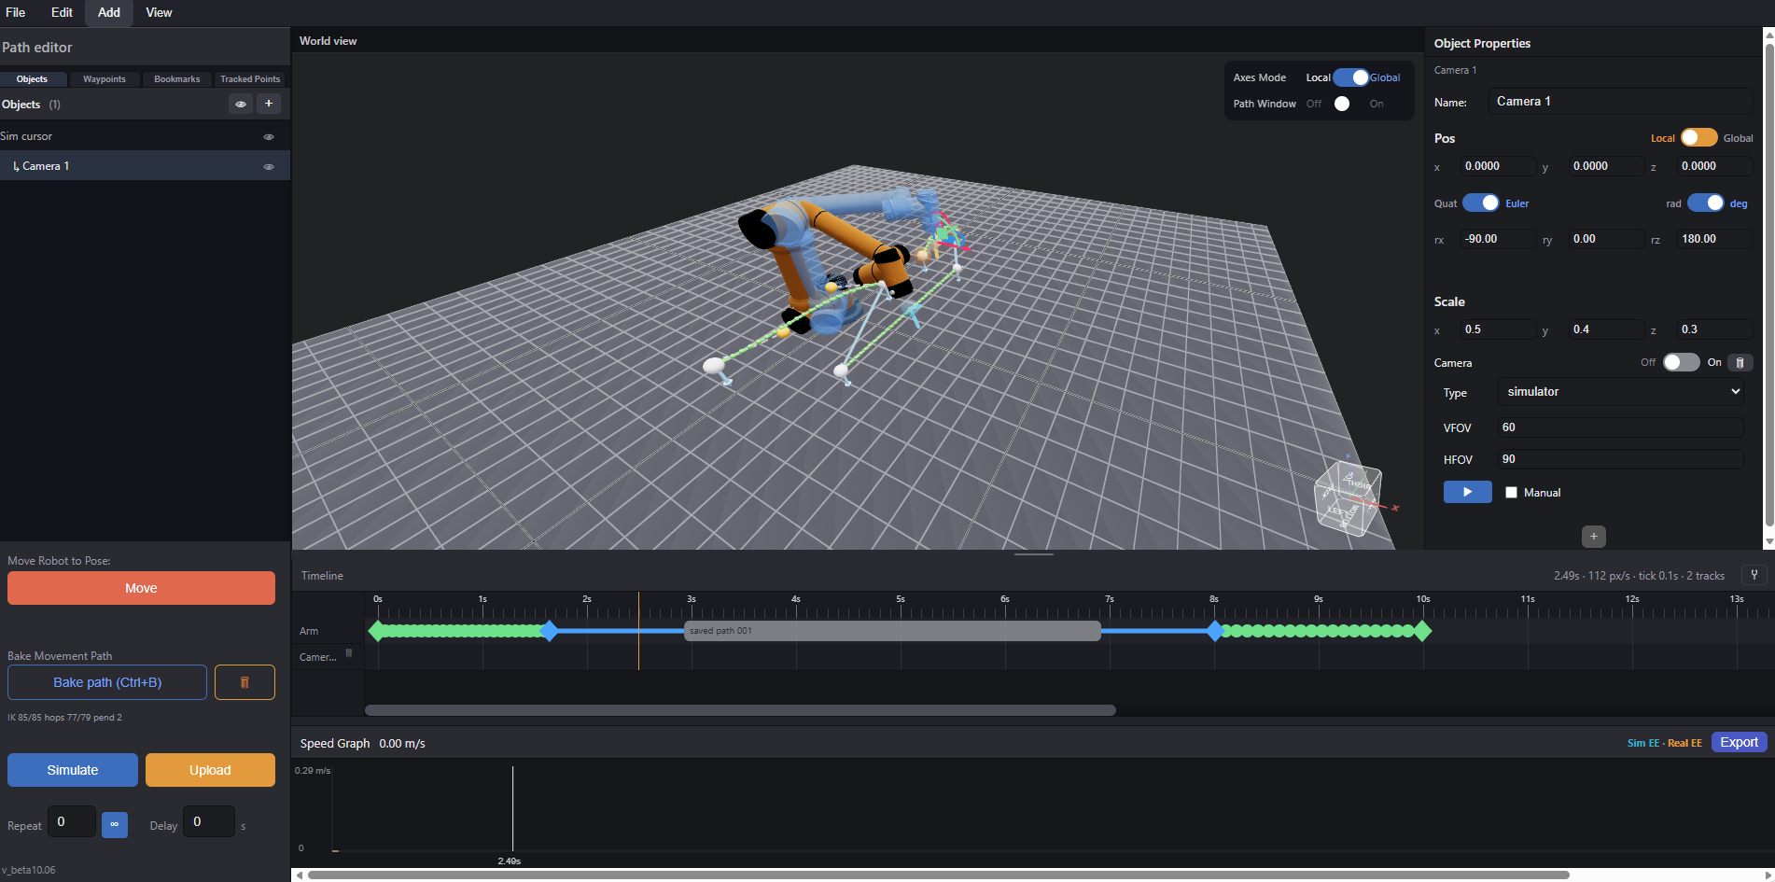
Overview
Main View
List of Elements
Object Properties
Timeline
Control Panel
Speed Graph

Slide 3
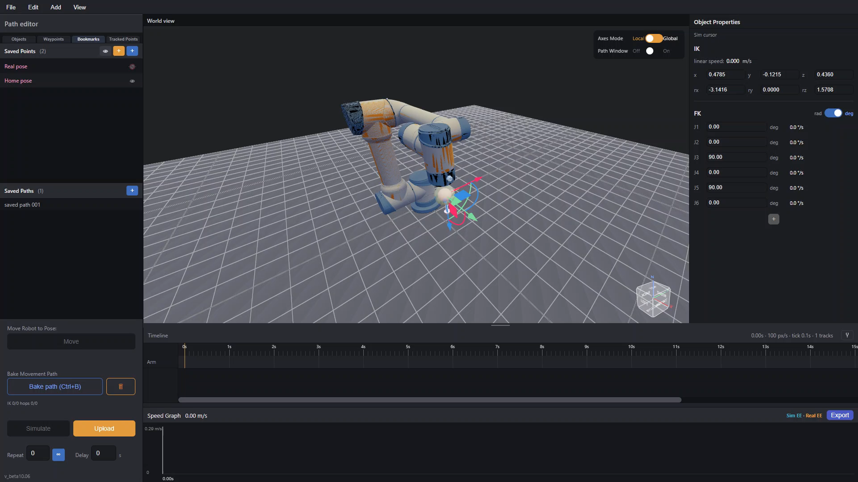
Basic Controls
Taken from any simulator out there
Should be added to video shoot UI
Drag in 3D space (left click) to rotate view, right click drag to move around
- Simply select the simulation robot’s EE controller (simbot cursor) to render transform axes gizmo
Drag the axes to move and rotate robot pose
IK is calculated in real time, if IK fails, robot freezes until it can solve the IK again
Axes mode can be switched to fit world axes for positional changes and local axes for changes relative to EE pose

Slide 4
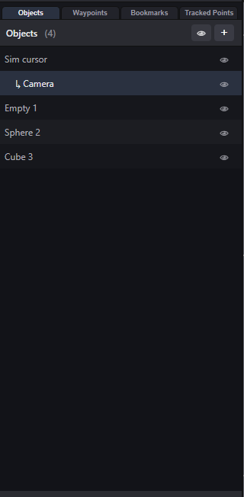
List of Elements
Tabs
Number of Items
Item
Shows list of all the elements present in the scene,
including:
Waypoints
Bookmarked positions
3D objects
Users can add these elements in the appropriate tab
with the “+” button and toggle visibility with “eye” button
Toggle Visibility (All)
Toggle Visibility (Single)

Slide 5
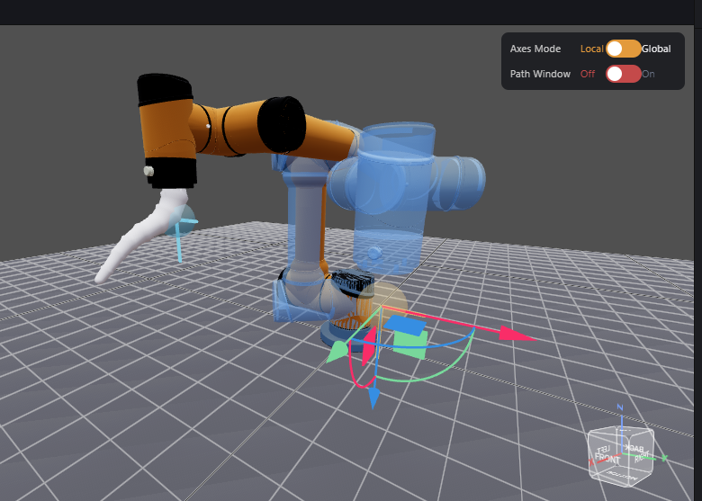
List of Elements: Objects List
Taken from Unity
Shows and Adds 3d objects to scene
Sim bot is displayed as “sim cursor”
Users can add additional simple or even custom .stl
3D objects to simulate environment
Users can even add advanced objects like cameras to
simulate camera position in sim world
Parent Hierarchy System:
  Users can parent objects such that they move together with their parent:
    Useful for binding objects to EE, eg. EE bound cameras
Imported .stl object bound to robot EE

Slide 6
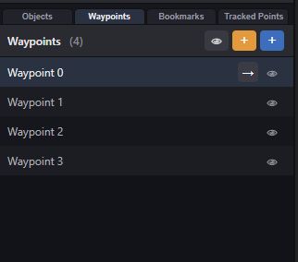
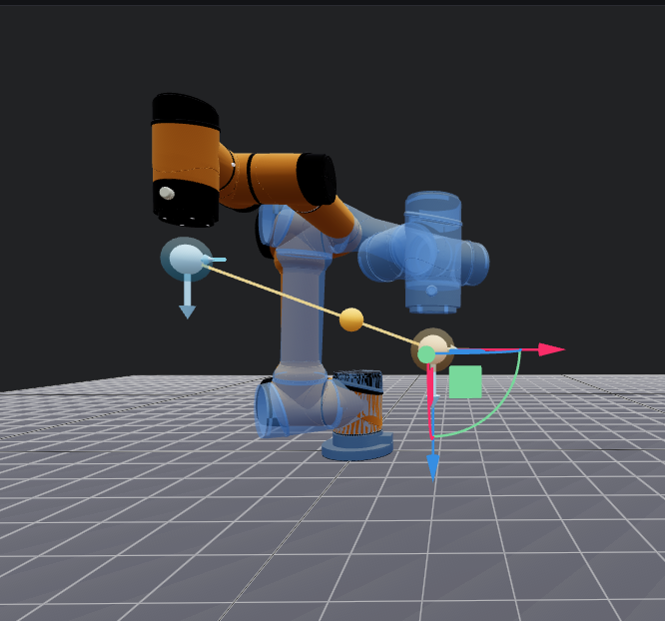
List of Elements: Waypoints
Should be added to video shoot UI
- Lists and adds waypoints (points used to create robot motion path)
in 3D sim space
Orange to add point from real robot pose
  Ideal for hand drag path planning
Blue to add point from sim bot pose
  Ideal for simulation dragging poses
No true hand drag planning:
true hand drag requires recording every point per ms
->200+ points for simple path
-> minor mistake gets recorded easily
+ 200 points to modify ->infeasible to fine tune each point
- Solution: Bezier curve path design
Waypoint made from real pose
Waypoint made from sim pose

Slide 7
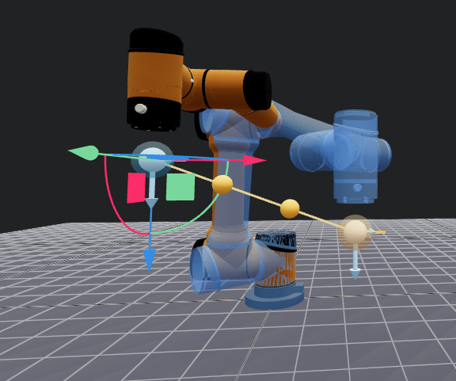
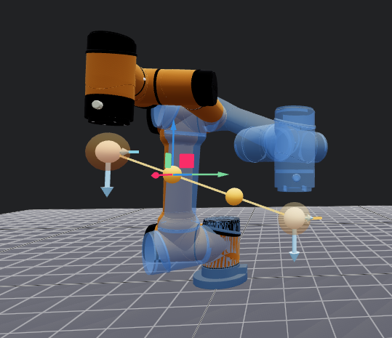
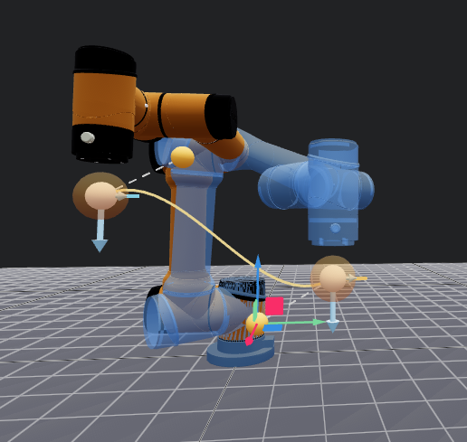
List of Elements: Waypoints
Should be added to video shoot UI
Click on waypoint to render dragging points
Click and drag the points to generate curve
Result: cleaner curves for motion paths that are easier to customise

Slide 8
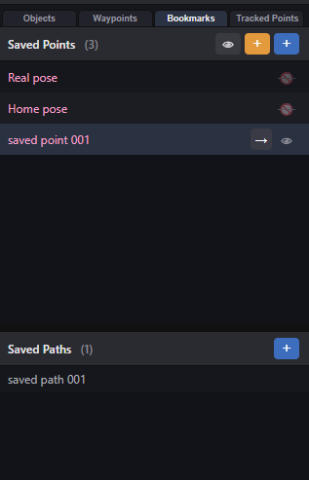
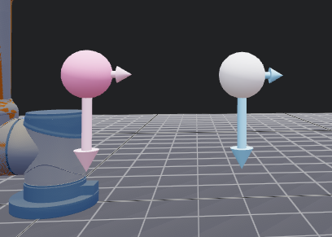
List of Elements: Bookmarks
Saved Points:
Lists and stores important poses to be used by sim bot
Add points with same logic as adding waypoints
Click arrow button to teleport sim bot to the specified pose
Important poses added by default include:
- Home pose (right angle pose)
- Real pose (real bot’s current pose)
Bookmarks can be saved either locally per project, or globally to be shared across multiple files
Right hand direction
Main direction
Saved Paths:
Stores and loads entire motion paths
(to be explained later)
Saved point (Pink)
Waypoint (White)

Slide 9
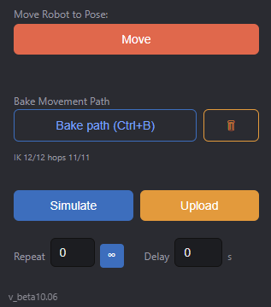
Control Panel
Move real robot to sim bot pose
(linear speed adjustable in settings)
Bake Path:
Generate sample points along the path in constant spacing (adjustable distance) to approximate path
Check if points are valid poses (IK check)
Check if points are valid speed (speed check)
Simulate path run after bake
Run path after bake
Set motion path to be repeatable (untested)
Non video shooting related

Slide 10
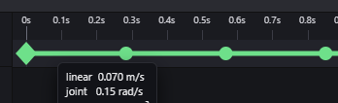


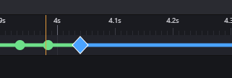
Path Baking
Should be added to video shoot UI
1. Generate Sample Points to approximate path
  Sample points are jotted by distance instead of time as the time frames are adjustable in the timeline post bake
2. To check if path has valid Iks
3. To Check if points are spaced and timed appropriately such that robot does not run over speed (Note: speed test seems to pass no matter what at the moment)
Any changes to timeline or waypoints position requires a full rebake
Bake States: white/Grey: Unbaked, Red: IK failed, Green: Everything OK, Blue: Force FK Mode (to be elaborated later), Orange: IK OK but speed too fast, Yellow: IK checked but not yet speed
Yellow state bugged
Waypoints passed bake
Waypoints failed bake
Waypoint passed bake
but is too fast
Waypoint using Force FK

Slide 11
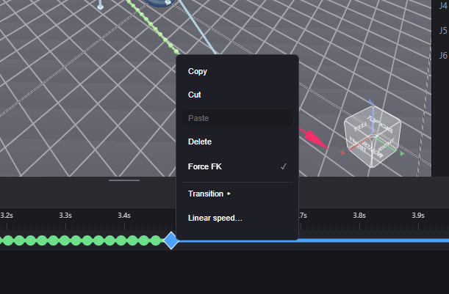
Path Baking: Force FK
For paths where final position is more important than the path shape itself, Or when waypoints are placed too complex and IK in between keeps failing,
user can set waypoint to “Force FK” mode such that the no sample points are created within the path segment -> direct moveJ between the 2 waypoints

Slide 12





Simulate and Play
Both states only run after a completely fine bake
Simulate
Simulate motion path in 3d world view
Pause available
Adjust timeline cursor to replay certain parts of path
Run
Upload path to robot first
Hold button to move robot to init pose
Run path
Pause not available, but interruptible

Slide 13
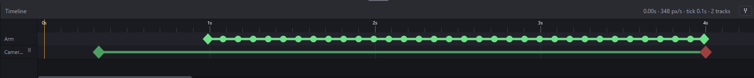
Timeline
Taken from animation software (ie Blender)
Should be added to video shoot UI
cursor
Arm track:
Diamond Frames: waypoints
circle frames: generated sample points
By default the sample points are equally spaced on generation (first bake), they can then be dragged to customise speed, rebake again to run speed check
Snap to grid toggle
(bugged, not working atm)
Camera track: (elaborated later)
Green Diamond: start record
Red Diamond: stop record
(note there is delay sending the command to sony camera)

Slide 14
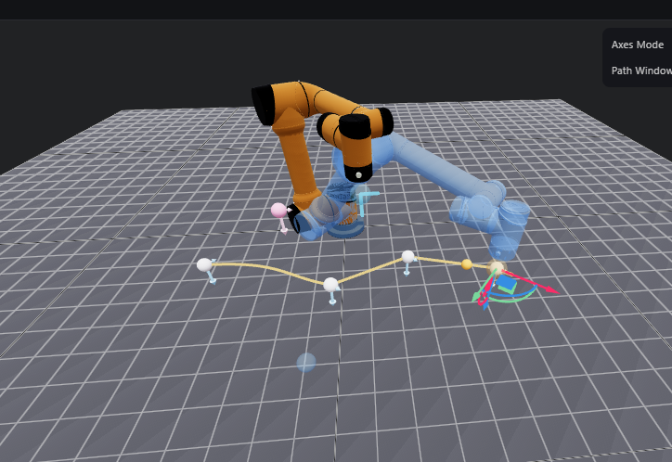
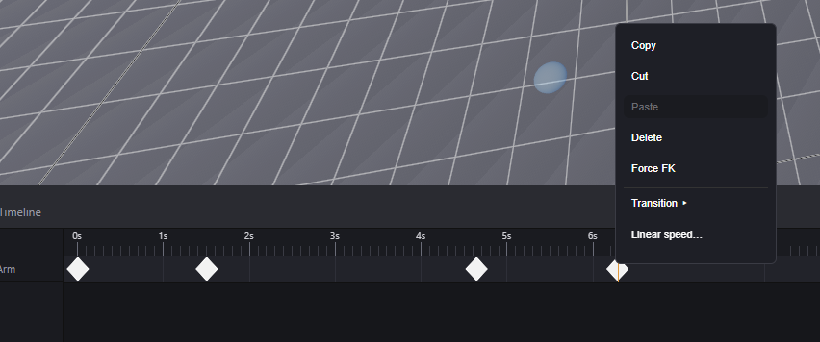
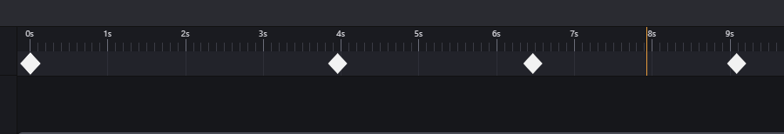
Timeline: Linear Speed
Path
Spaced by path distance
For irregular paths with constant linear speed, users can select the range of waypoints and use the “linear speed” option to set the path segments(s) to be run at the constant desired speed,
program calculates distance of path and approximates time required for robot to reach destination at given spee

Slide 15
Timeline: Transitions
Other than manually dragging each point by hand, user can use default transitions to set acceleration of path segments
Note: Transitions are spaced mathematically without regard of path distance and robot max speed
-> fast segments can go really fast, safety check WIP
custom drag
linear
Ease in
(slow -> fast)
Ease out
(fast -> slow)

Slide 16
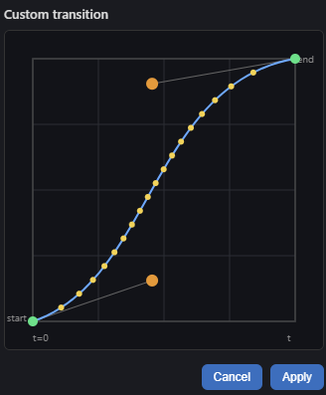
Timeline: Transitions
waypoints
Sample points
User can also customise transitions with Bezier curves, but feature is untested
waypoints

Slide 17
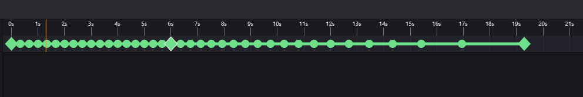
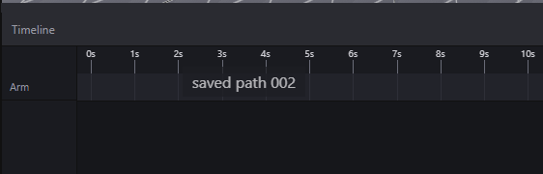
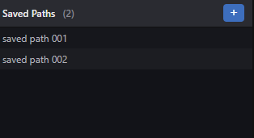
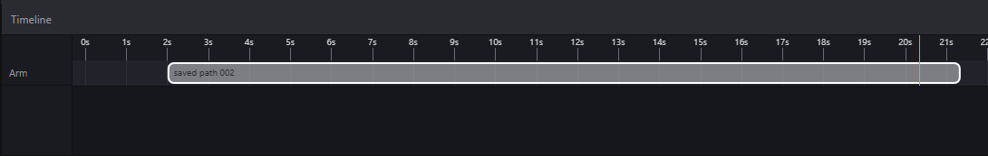
Saved Paths
Taken from Video Editing software (eg. Premiere Pro)
Users can save entire timeline into a block (saved path)
Like saved points they can be saved locally or globally
Users can drag saved paths onto timeline to reuse specific paths or simply use default given paths for simplicity
Save to
Load

Slide 18
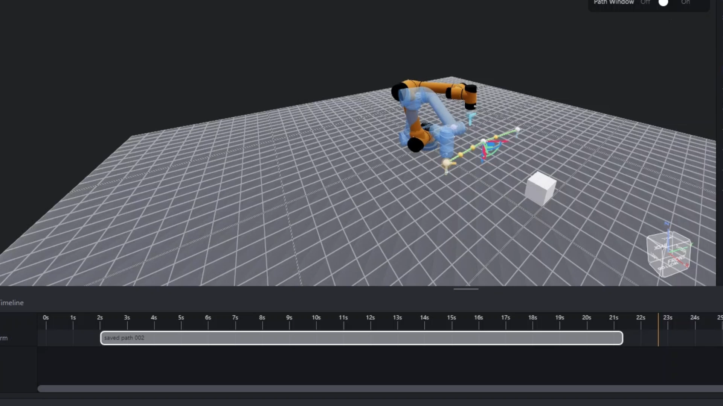
Saved Paths
Saved paths can be used in conjunction with regular waypoints
At the moment segments connected to paths are Force FK mode by default for simplicity (avoid path editing for inexperienced users that rely on saved paths)
Experienced users can unwrap saved paths back to individual waypoints for customised edits

